Slide 1
Vergleichende Politikwissenschaft als Forschungsprojekt
Prof. Jessica Fortin-Rittberger, PhD Department of Political Science
Universität Salzburg
Rudolfskai 42
5020 Salzburg
Tel.: +43 66280446609
j.fortin-rittberger@sbg.ac.at

Slide 2
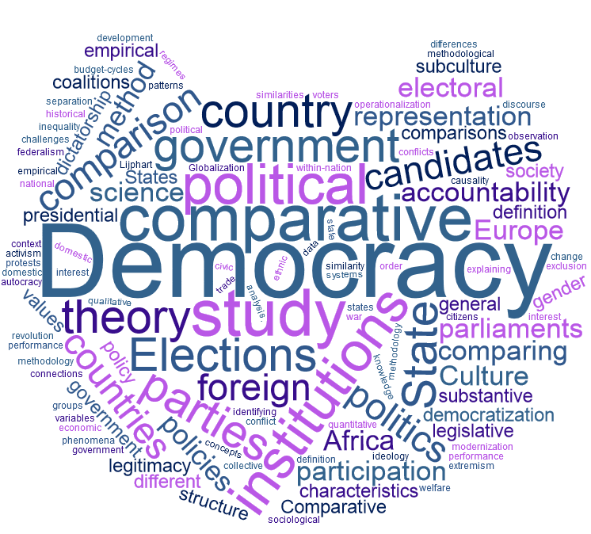
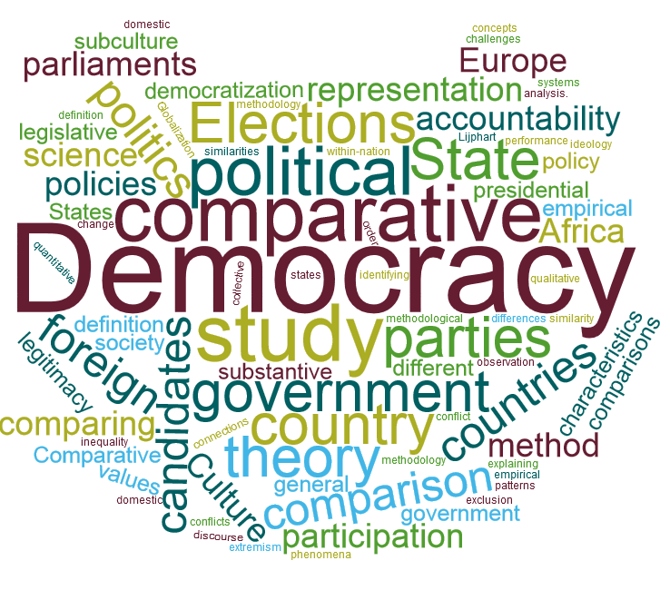
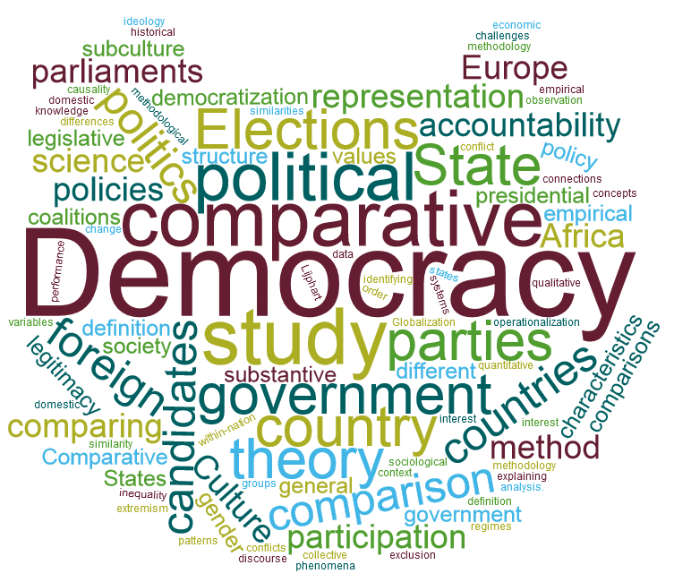

Slide 3
Empirical treatment
of Democracy
Quality
of
Democracy
Democratic
Theory
Challenges
to
democracy
Functioning
of
democracy
Effects
of Democracy
Causes
of
Democracy

Slide 4
Quality
of
Democracy
Challenges
to
democracy
Functioning
of
democracy
Causes
of
Democracy

Slide 5
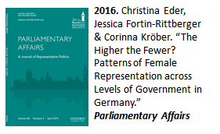
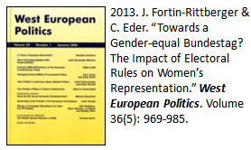
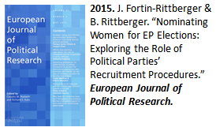
Legitimacy
Accountability
Representation
Performance
Quality
of
Democracy

Slide 6
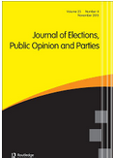
Democratic institutions
Voting and elections
Governments/Legislatives
Public policy
Governance
Collective action
Mass values
Political participation
Functioning
of
Democracy
2017. J.Fortin-Rittberger, P. Harfst & S. C. Dingler. “The Costs of Electoral Fraud.” Journal of Elections, Public Opinion & Parties. Volume 27(3): 350-368.

Slide 7
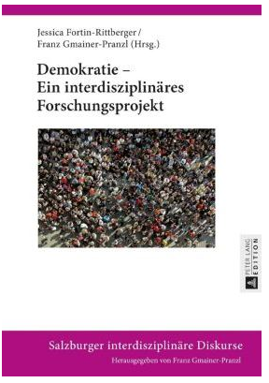
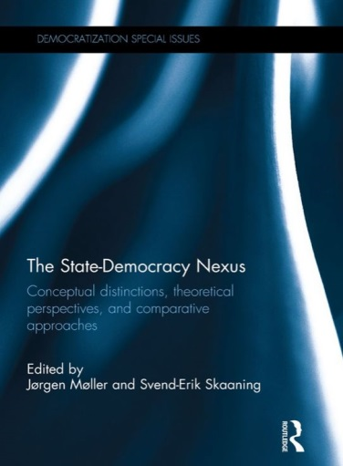
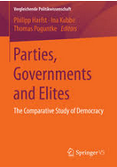
What causes and sustains democracy?
Causes
of
Democracy

Slide 8
Effects
of Democracy
Globalization
Economic crises/processes
Conflict over values
Inequality and exclusion
Rise of extremism and challenges to democratic legitimacy
Can consolidated democracies fail?
Challenges
to
democracy

Slide 9
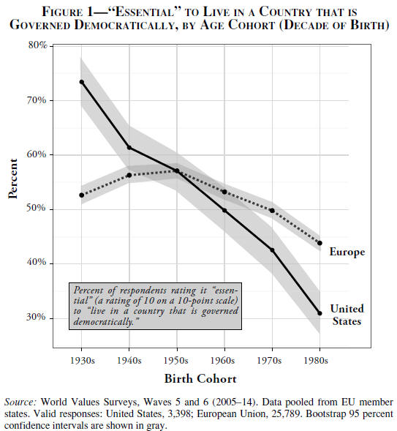
Fewer young people think democracy is crucial
From: Roberto Stefan Foa and Yascha Mounk. 2016. “The Danger of Deconsolidation: Democratic Disconnect", Journal of Democracy, Vol. 27(3).5-17.

